Slide 1
Open science and reproducible research in Ecology
Gabriel Nakamura - National Institute of Science and Technology – Federal University of Goiás - Brazil

Slide 2

Notes:
Starting with a disclaimer regarding the content of this presentation today:
1- Don’t take it personally… this presentation is mostly based on my own errors during my academic life, and my aim here is to make people aware of them and not repeat them in future research…
2 - Why I’m talking about this. Basically, my direct experience is based on classes I gave to graduate programs. More about the use of practical tools for reproducibility that you’re gonna see plays a central role in open science

Slide 3
Next 25 minutes
What is and what is not open science? Some mistakes and definition on open science concept
Open science and reproducibility (mainly computational)
Some resources to improve open science and reproducibility (Where to start?)
Some questions to think about
Notes:
So after this disclaimer, for the next 20-25 minutes, I’m gonna talk
First, about what I mean by open science, and maybe most important, what it isn’t open science.
Then I’m gonna show that open science and reproducibility are very connected. Focusing on the computational aspect of reproducibility because it’s the topic that I’m more familiar with, but also we are gonna discuss some philosophical aspects of reproducibility
Finally I’m gonna show how to start with open science and reproducibility in practice, by showing some computational resources
And I’m gonna finish it with some questions so we can discuss about

Slide 4
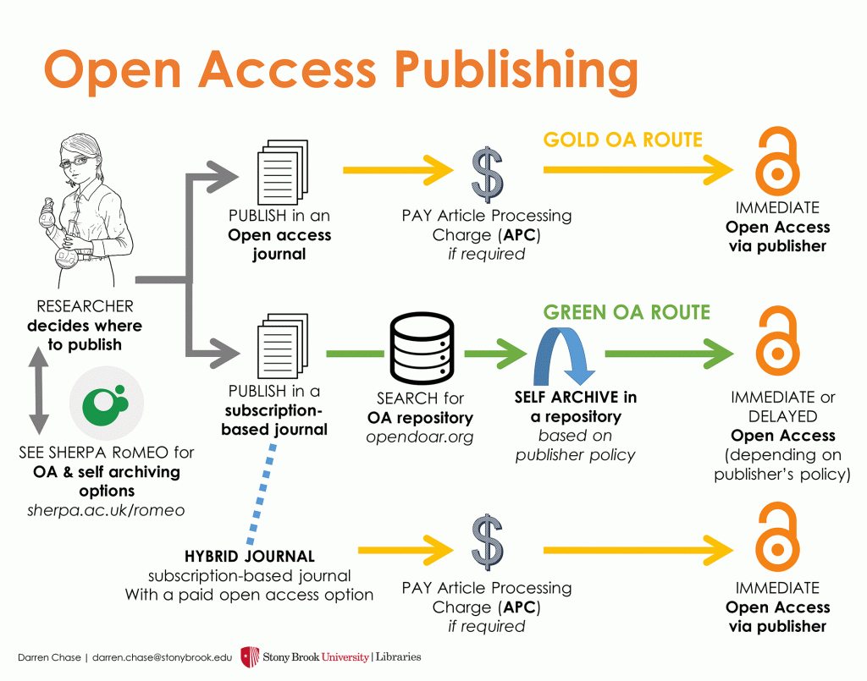
Open science
What is open science (or what it isn’t)?
Open Science
Notes:
So, first, when we talk about open science, it is important to know that we are not talking about open access. An article openly available doesn’t necessarily mean it was conceived following the ideas of open science. Why? Because the article is only the final product, and open science is more than a product. It’s a process in which the final product is conceived.

Slide 5
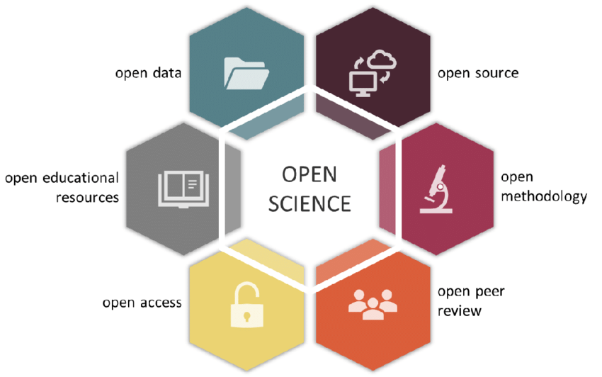
Open science
What it is?
Open science is about the process, not the final product
Umbrella term for different movements to remove barriers
Extending the principle of openness to the whole research cycle
https://www.nature.com/articles/s41559-020-1109-6
Notes:
So, basically, open science is a set of processes when doing science. The spotlight is not on the final product, the publication, the publication, or the journal, or if it is open access or not. The focus is on the procedures to achieve the most high-quality publication in terms of reproducibility and access

Slide 6


Open science
What it is?
Open science is about the process, not the final product
Umbrella term for different movements to remove barriers
Extending the principle of openness to the whole research cycle
Open science has at its core the reproducibility concept
https://www.nature.com/articles/s41559-020-1109-6
Notes:
So, open science involves all those steps, and today I’m gonna focus basically on those four pillars when doing open science and reproducible research, that is open data, open source, open methodology, and open resources to spread or facilitate the communication of discoveries. Open peer review and open access are important but I think that they are more consequences of the other steps, specially open access articles, that we are gonna discuss later.

Slide 7
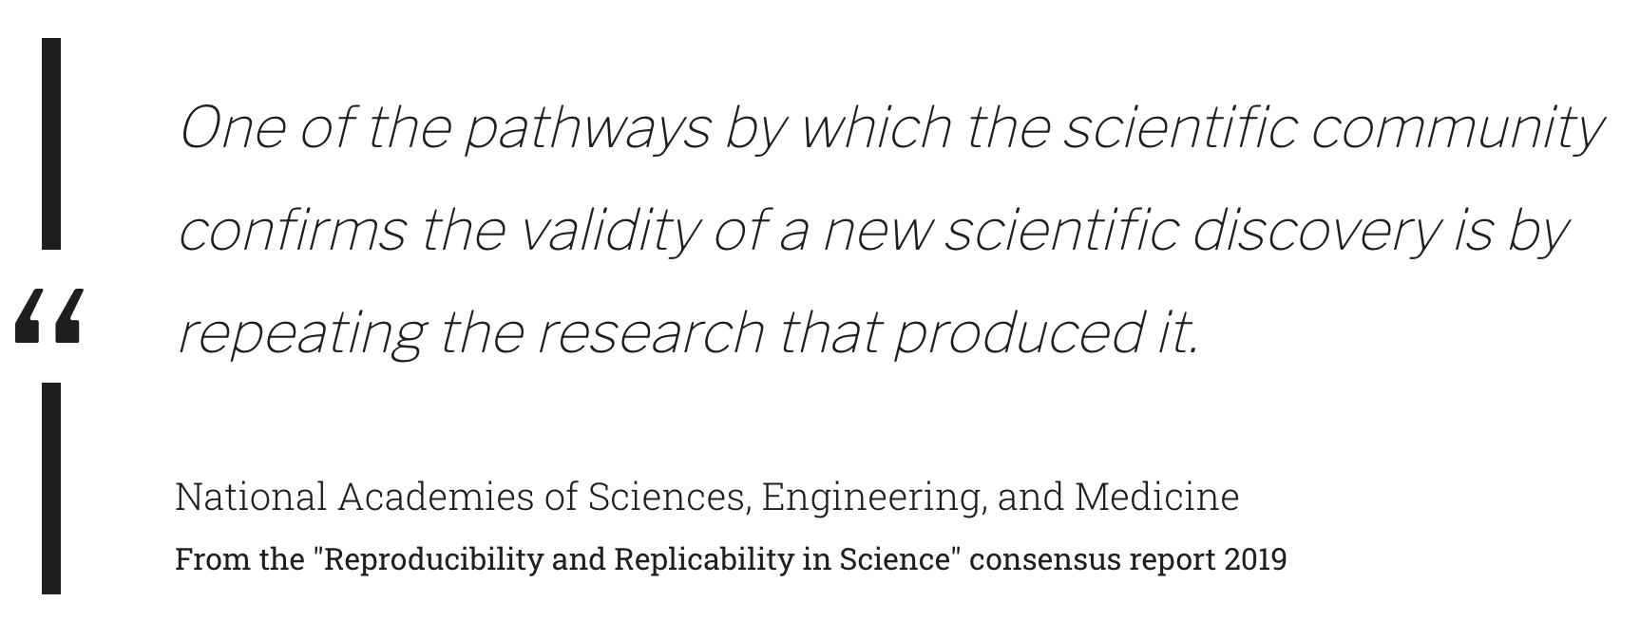
Open science and reproducibility
Science has reproducibility at its core
Guarantee the validity and the basis to build upon
https://unesdoc.unesco.org/ark:/48223/pf0000379949.locale=en
Notes:
Basically you notice that when talking about open science, it’s almost impossible not to talk about reproducibility. Why? First, reproducibility is at the core of scientific activity when we see the definition of reproducibility, that is, the capacity to replicate scientific discoveries. Reproducibility sets the ground for self-checking of scientific discoveries and also building upon what has been done. So if we don’t have truly open data, code, or research that can be checked and build upon we can achieve the open science.

Slide 8
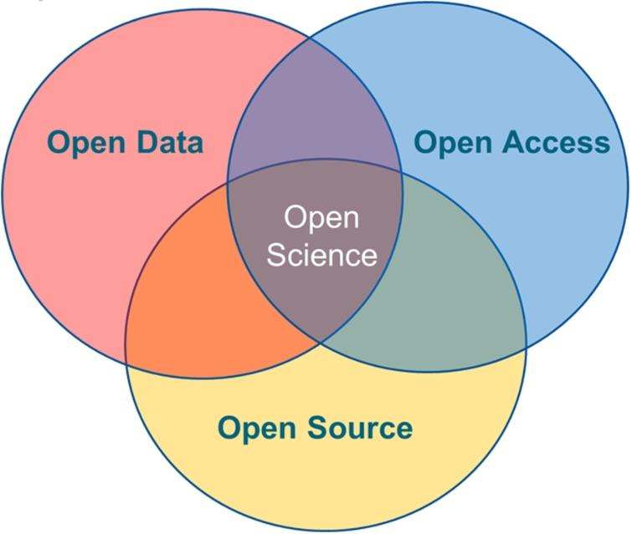
Open science and reproducibility
Science has reproducibility at its core
Guarantee the validity and the basis to build upon
Open data, source, and access are only possible in a reproducible system
Reproducibility
https://unesdoc.unesco.org/ark:/48223/pf0000379949.locale=en
Notes:
I like this figure because All the pillar of open science plays within the context of reproducibility. We can get open data and understand it to build upon it only if this data is feasible for reproducing

Slide 9
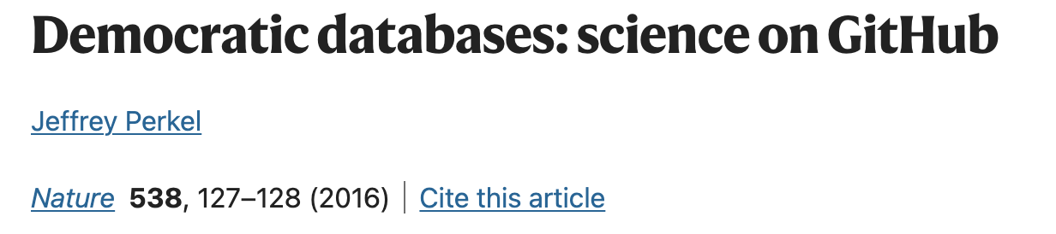
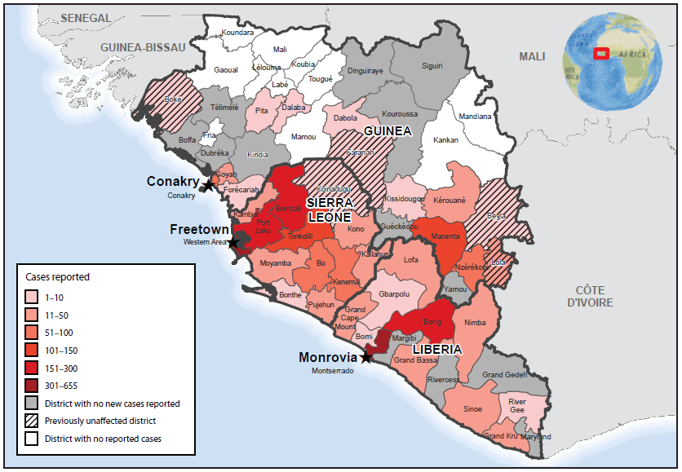
Why open science and reproducibility?
An example of open science and reproducibility
Ebola outbreak in Africa in 2014
Use of openly and reproducible available data
Fast improvement in counting and error checking
Notes:
So this is a very philosophical argument, but in practice, why do we need in our lives a more reproducible and open science? This is an interesting example from an article in nature. They show how the Ebola outbreak was contained and understood at a faster pace thanks to the reproducible and open nature of the data from researchers at the very beginning of the investigation.

Slide 10
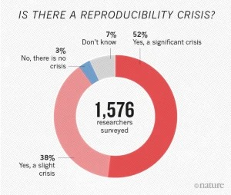
Why open science and reproducibility?
Improve the reliability and self checking mechanisms
Reproducibility crisis
Reliability and checking mechanisms
Is science trustful?
Notes:
Another reason is because its important to show how confident we can be about our scientific conclusions. The mechanism of checking and repairing errors is what make science the best tool we have to understand the world around us That make science trustful. And to to do that we have to be able to access and reproduce our findings in any scientific field. This graphic from an article publish in nature shows that most of the researchers in different fields are concerned about a reproducibility crisis in science.

Slide 11
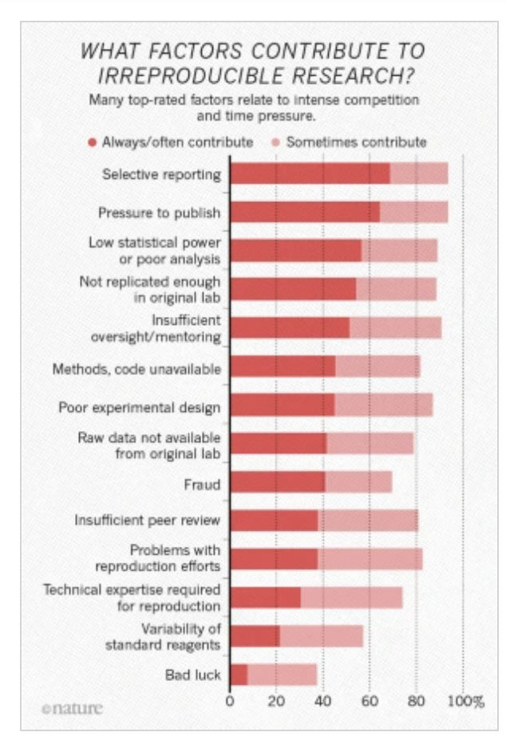
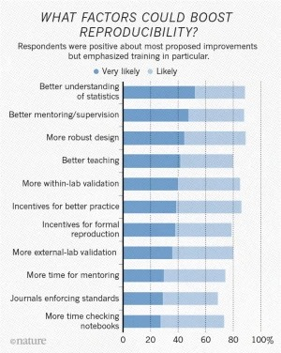
How to make science open and reproducible
What should we have been doing?
The emphasis on the process rather than the results
Good results are a consequence
Notes:
So, given the importance of open science and the reproducibility of all scientific fields what we should do to achieve a more open and reproducible science? First we have to know what are the factors generating the perceived crisis in reproducible science. In the same nature article the researchers ranked the factors that they judge important to generate this crisis that basically … and also they were asked about what could boost reproducibility and consequently open science.

Slide 12
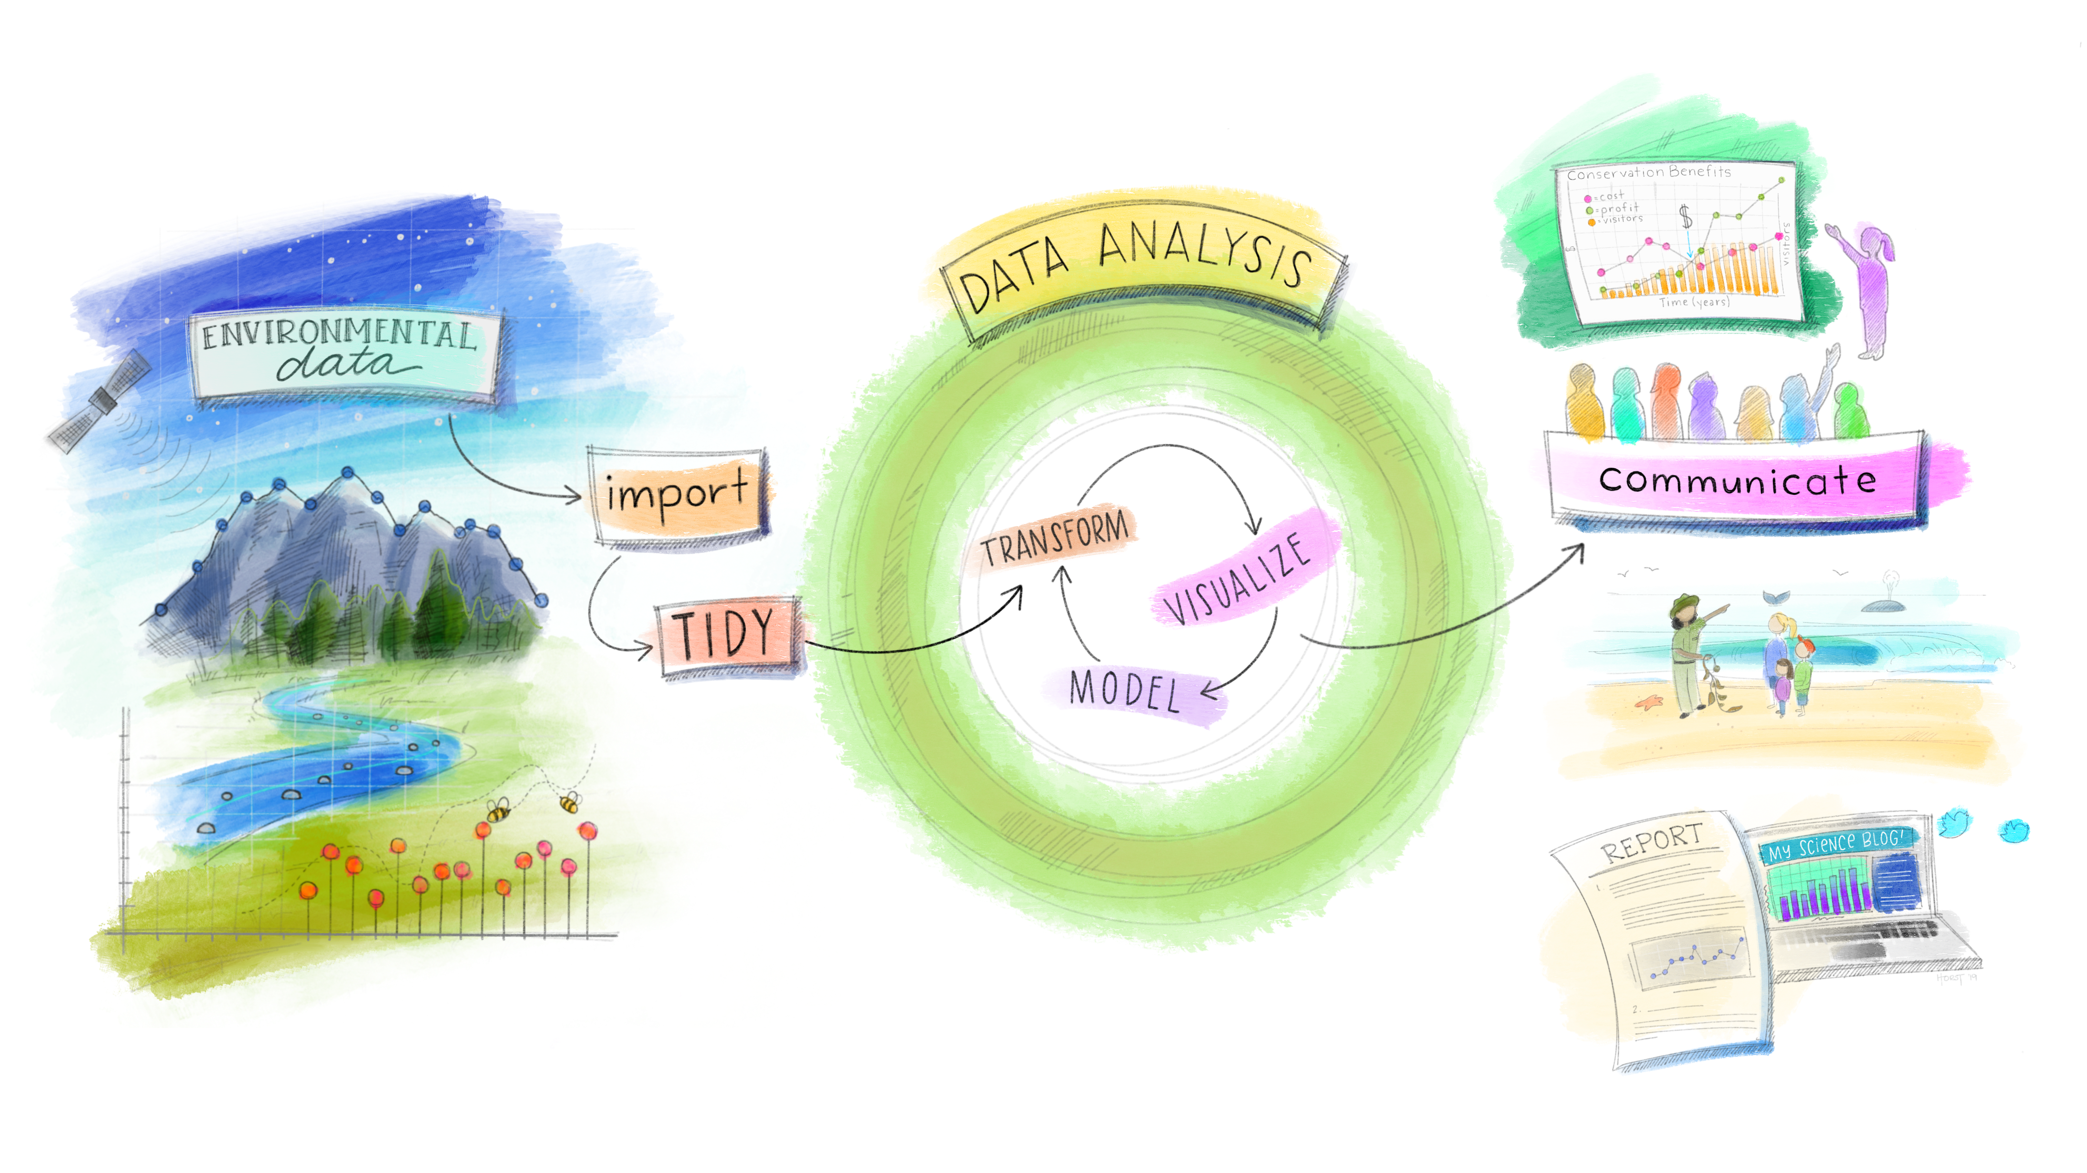
How to make science open and reproducible
Written description
Open softwares
Beyond the paper
Clear descriptions of methods and procedure
Open scripts and codes for all analysis
Facilitate access to results and communication
Notes:
From the individual perspective….

Slide 13
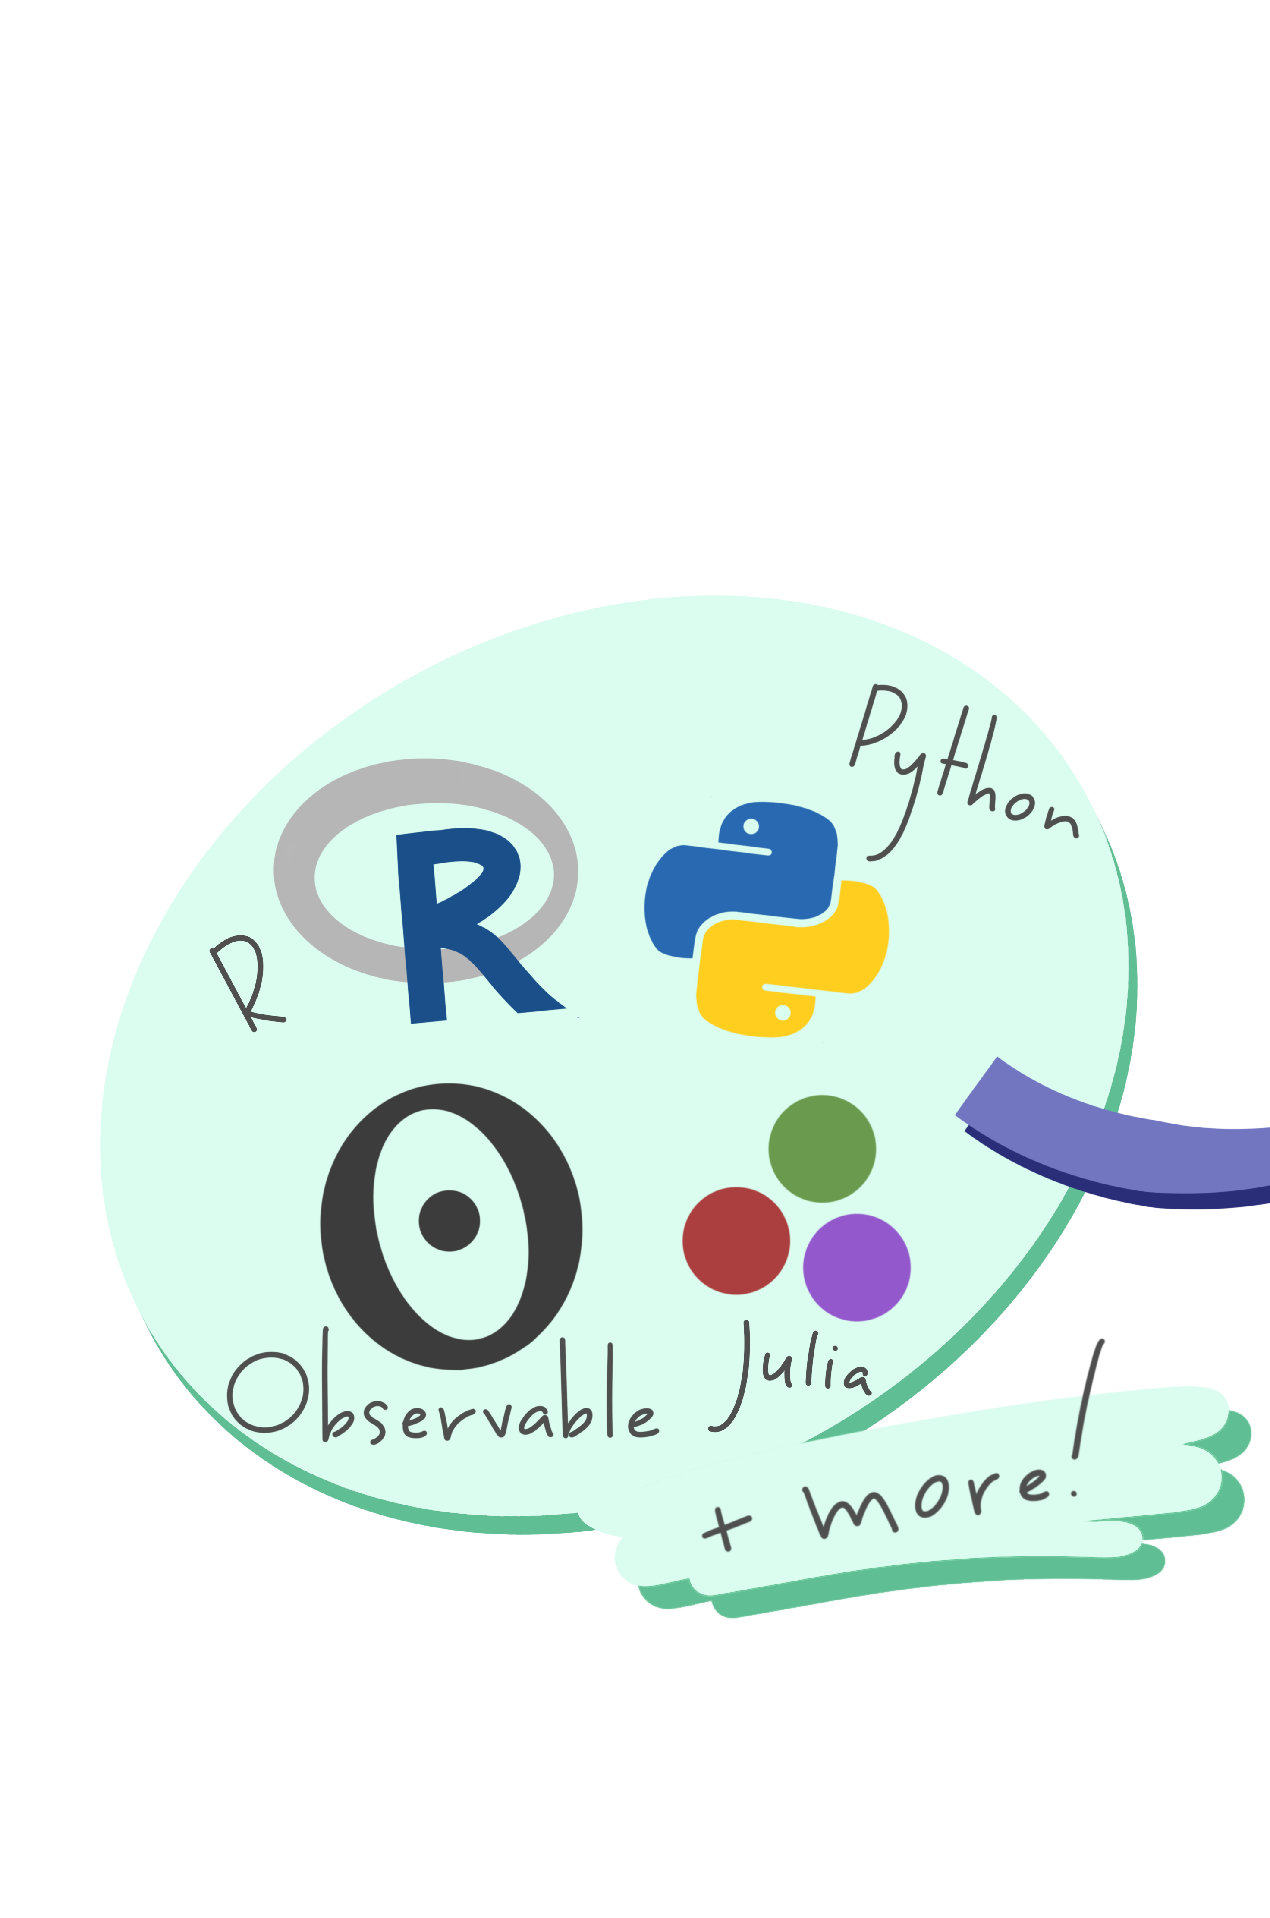
How to make science open and reproducible
Open softwares
Open software like R, Python, Julia
Notes:
Some tools that can help us to check all the boxes in that list and achieve a reproducible science..

Slide 14
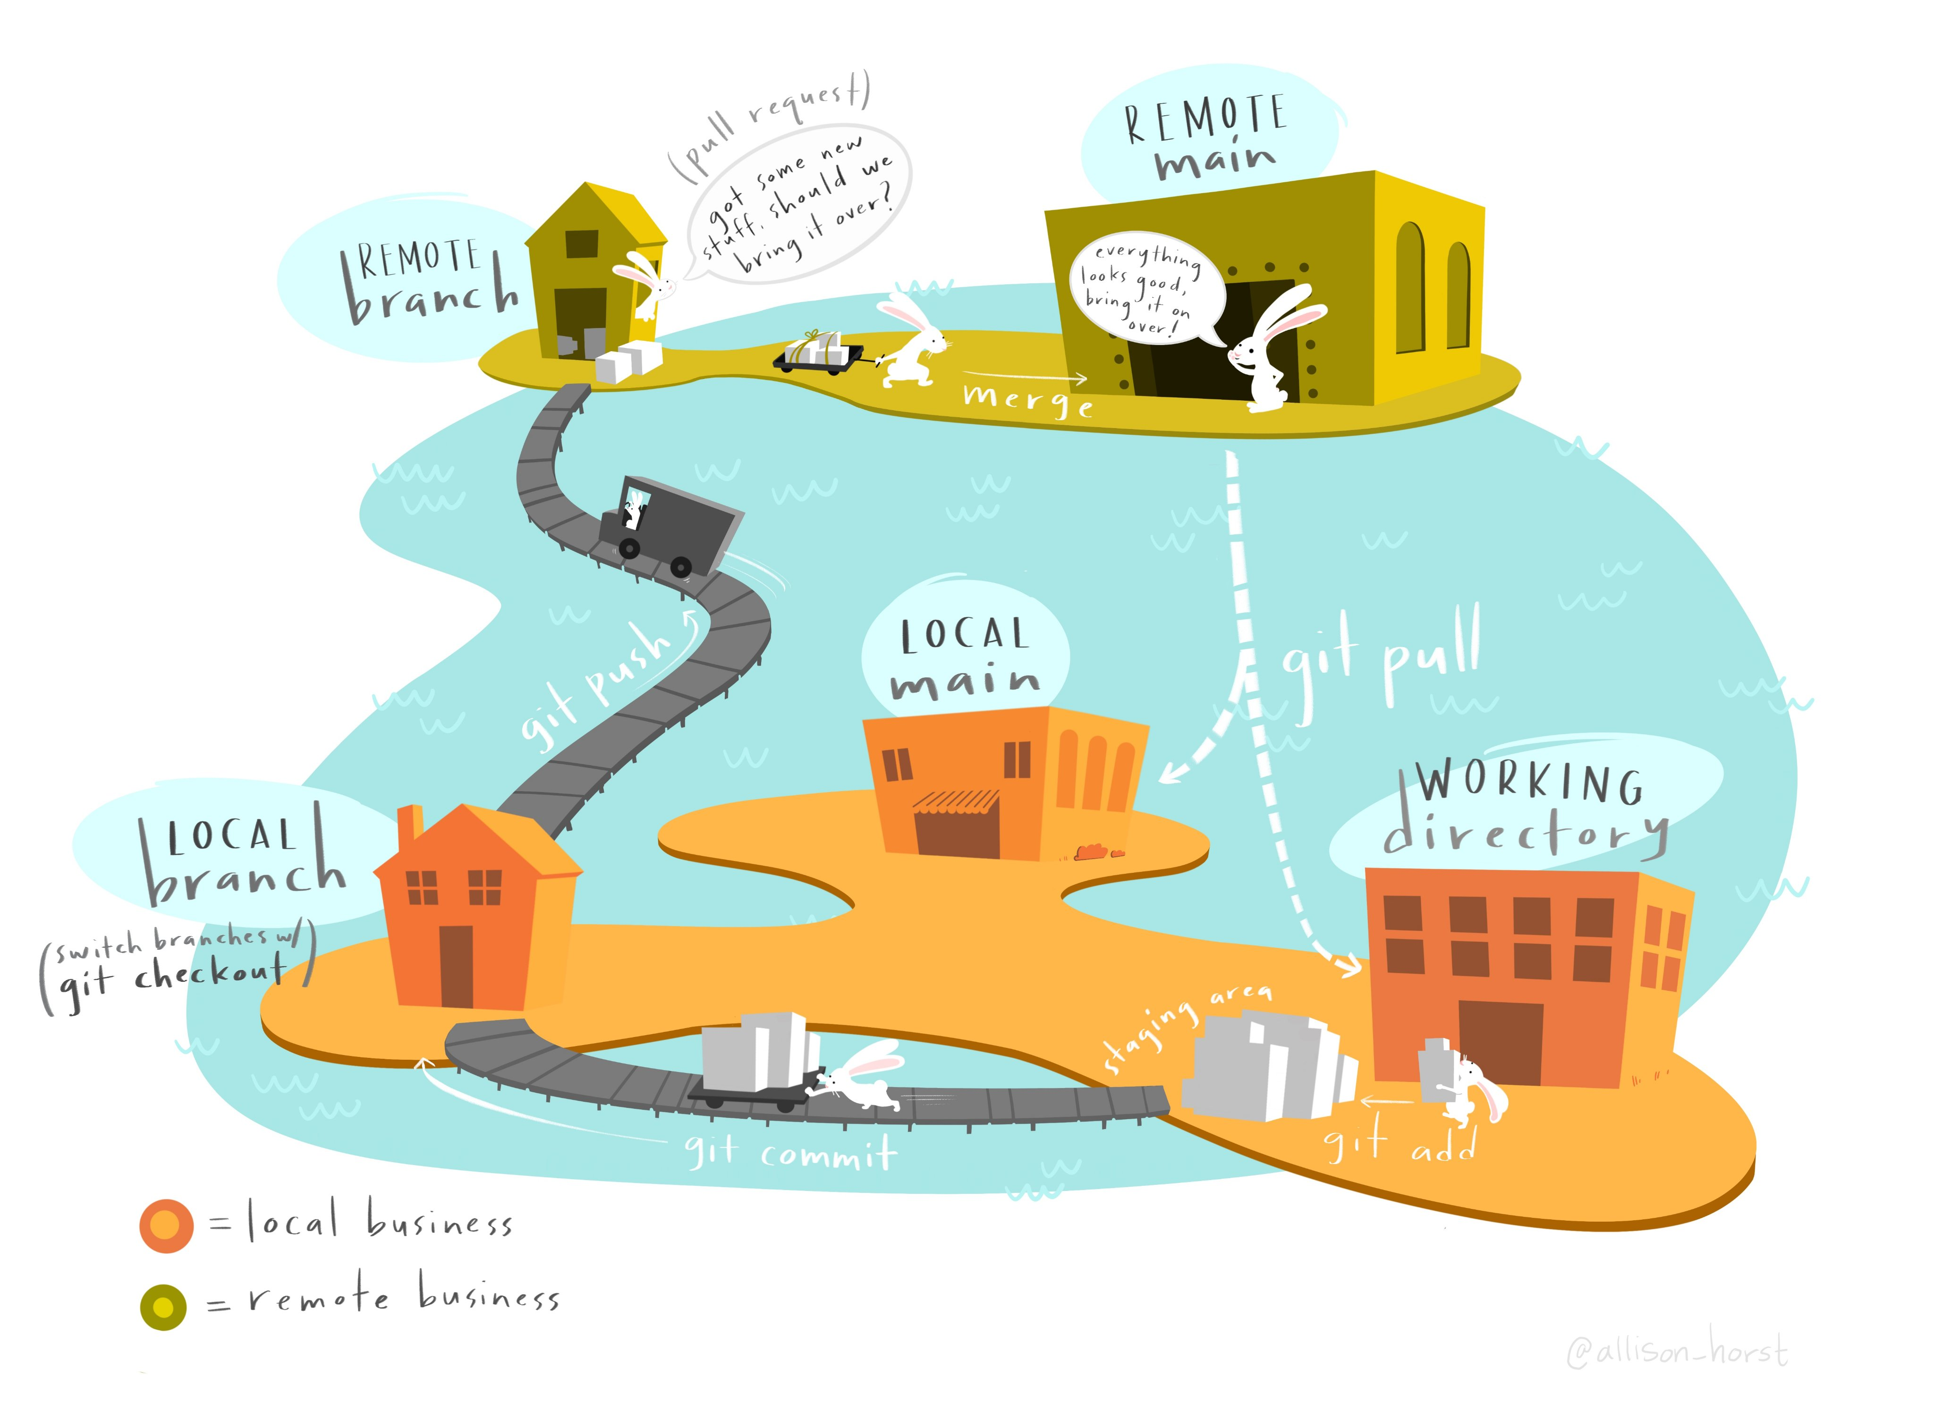
How to make science open and reproducible
Open softwares
Open software like R, Python, Julia
Use of version control tools: Git/Github (not only for the final version!!)
Enclosed environments (Docker, Rocker)

Slide 15
What you are about to learn today
GitHub
Your computer (local folder)

